Slide 1

Supermarket Sales Dashboard
Chart Explanation

Slide 2
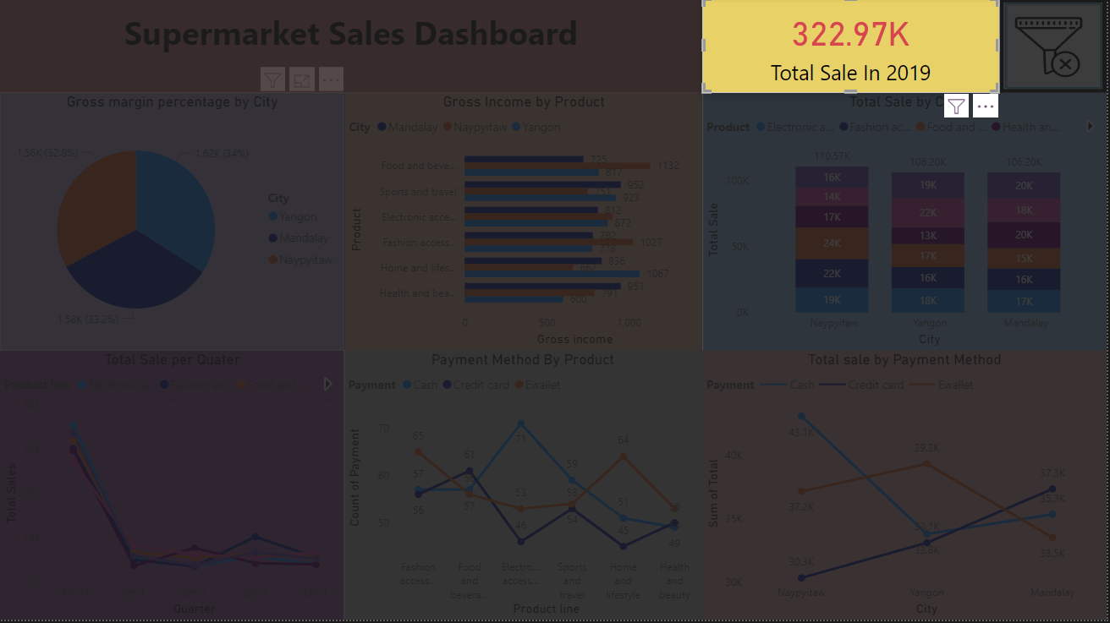
This box shows the total amount of sales in year 2019 including all the cities

Slide 3
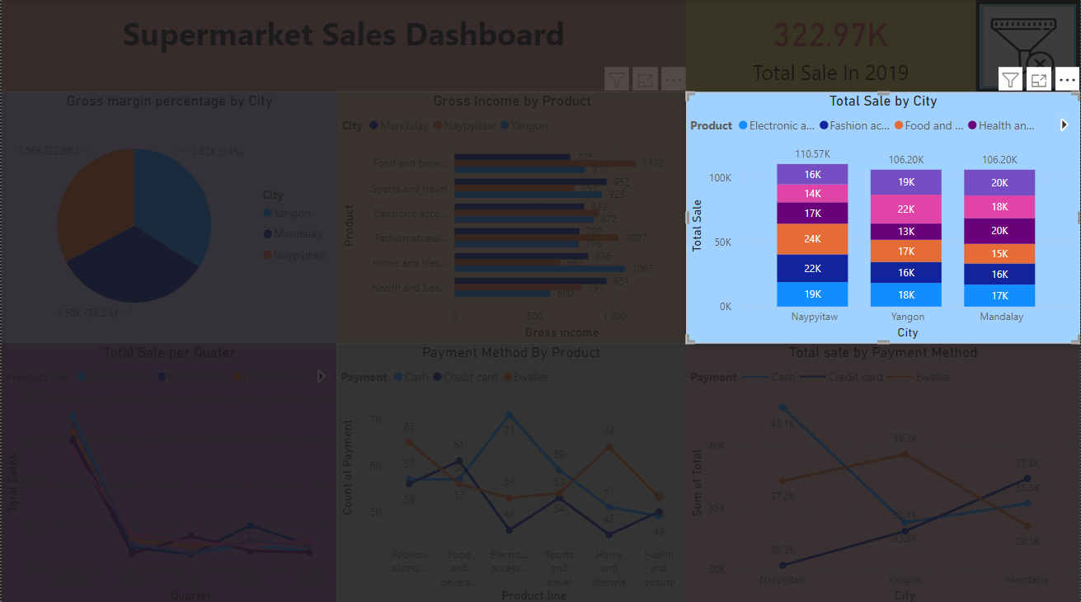
This columns chart represent total amount of sales of all the products with respect to each city.

Slide 4
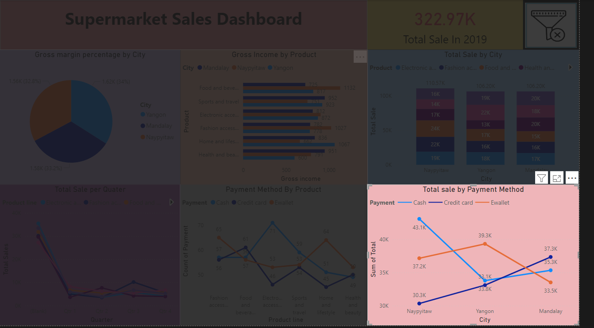
This line chart represents the payment method used for the transaction with respect to each city.

Slide 5
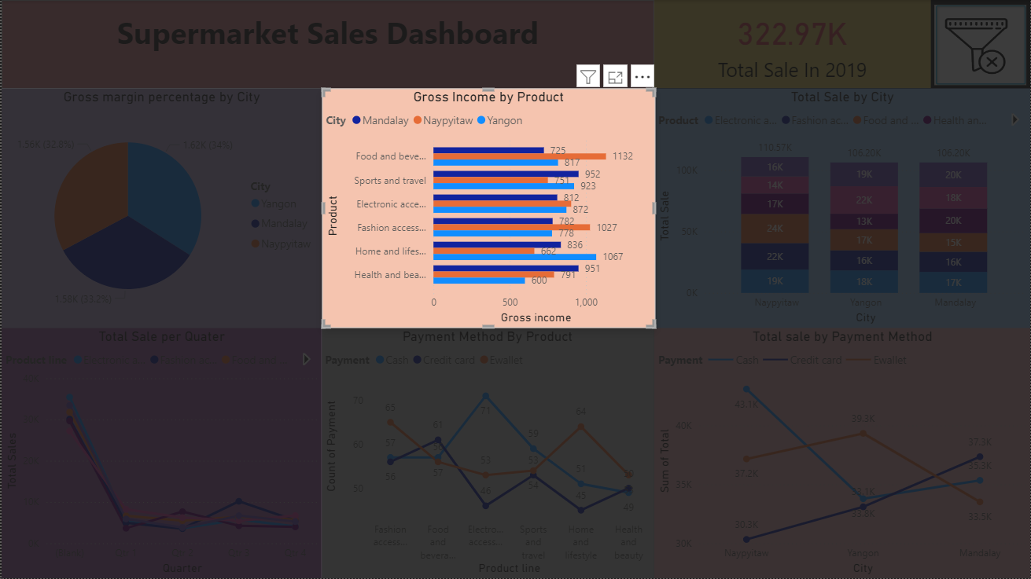
This bar chart represents the gross income for each city with respect to the products

Slide 6
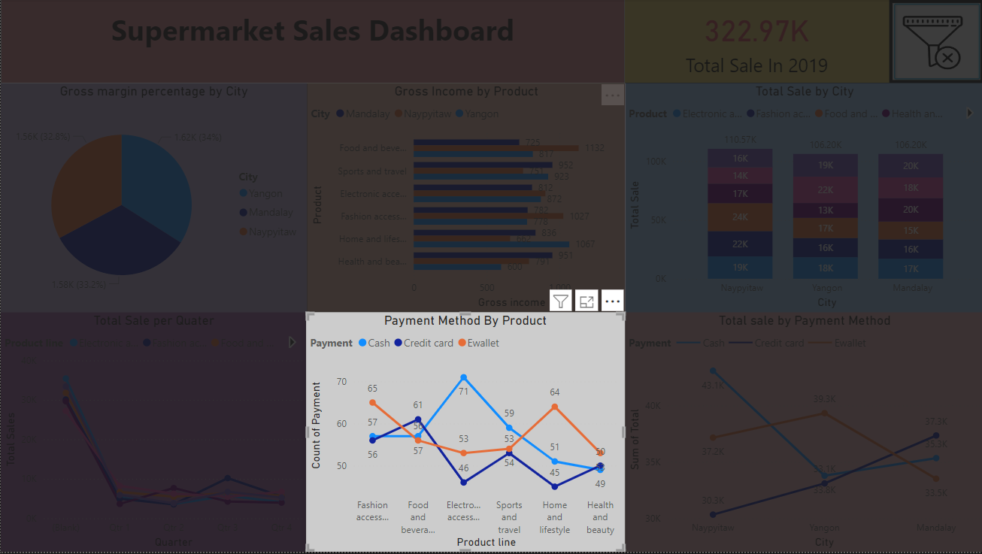
This visual represent the total method of payment used for each product

Slide 7
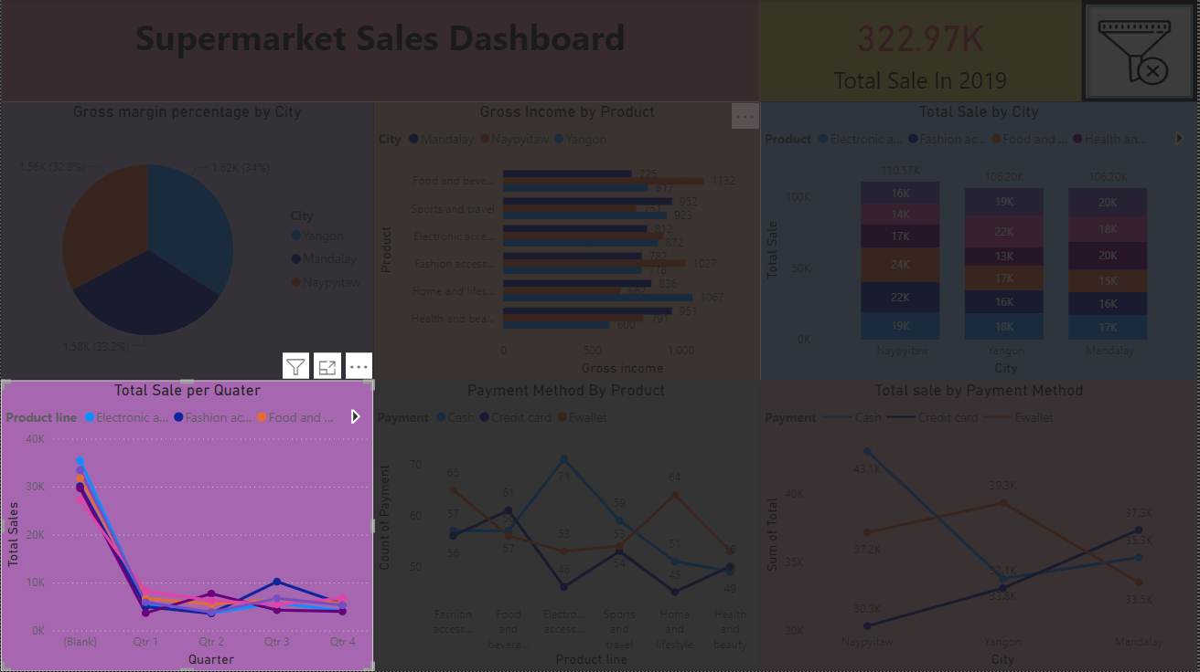
This visual represent the total sales of each product per quarter

Slide 8
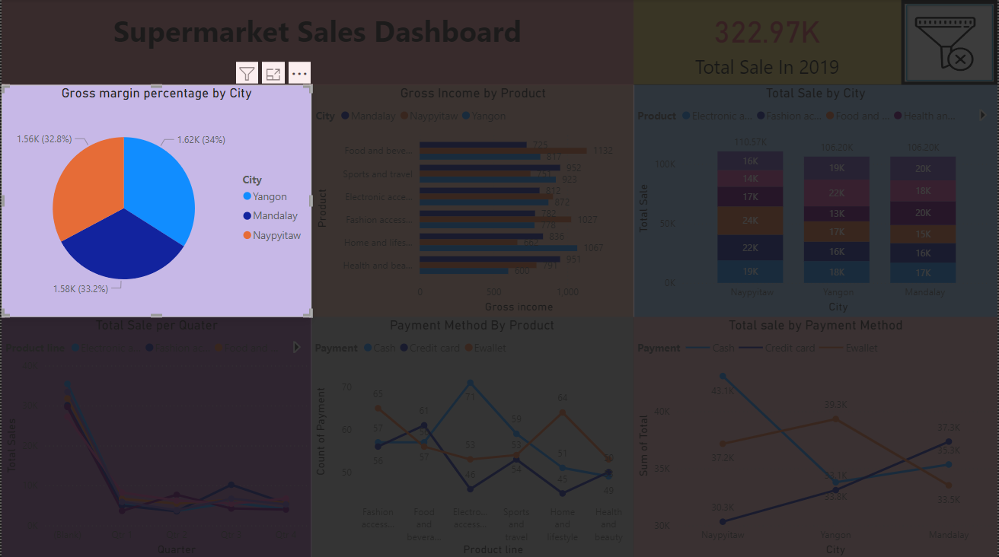
This visual represent the Gross margin percentage for each city

Slide 9
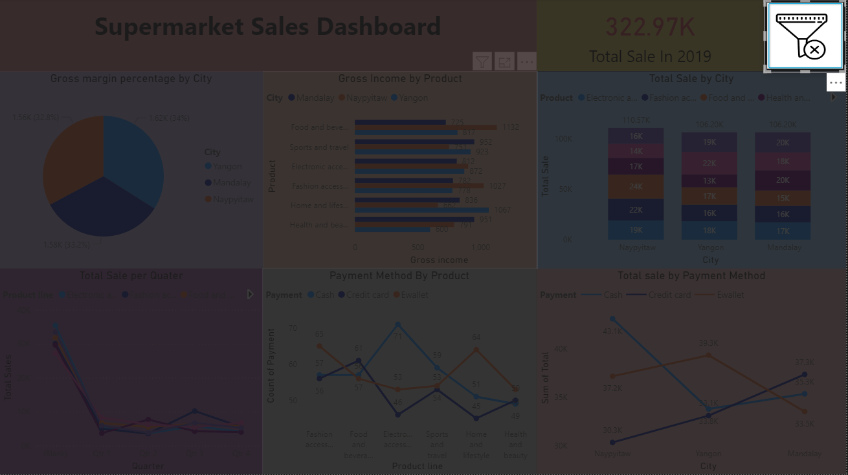
This visual is used to clear all the filters used in the dashboards

Slide 10
THANK YOU

